Slide 1

Quantum-Inspired Secure Authentication
Behavioral Biometrics Meets Post-Quantum Cryptography

Slide 2


Executive Overview
Traditional authentication systems face existential threats from advancing computing technologies. Password-based systems and conventional biometrics remain vulnerable to spoofing, replay attacks, and future quantum-based cryptographic exploits.
This research proposes a next-generation authentication framework integrating behavioral biometrics, quantum-inspired probabilistic identity modeling, and post-quantum cryptographic security for future-resistant protection.

Slide 3
Project Objectives
Multi-Layer Authentication
Quantum-Resistant Security
Develop integrated system combining behavioral biometrics with quantum-inspired encoding and post-quantum cryptography
Implement lattice-based cryptography and hash-based signatures securing identity storage and transmission
Continuous Authentication
Research Publication
Enable real-time monitoring with AI-based anomaly detection instead of one-time login verification
Build functional MVP and prepare results suitable for IEEE-format academic publication

Slide 4
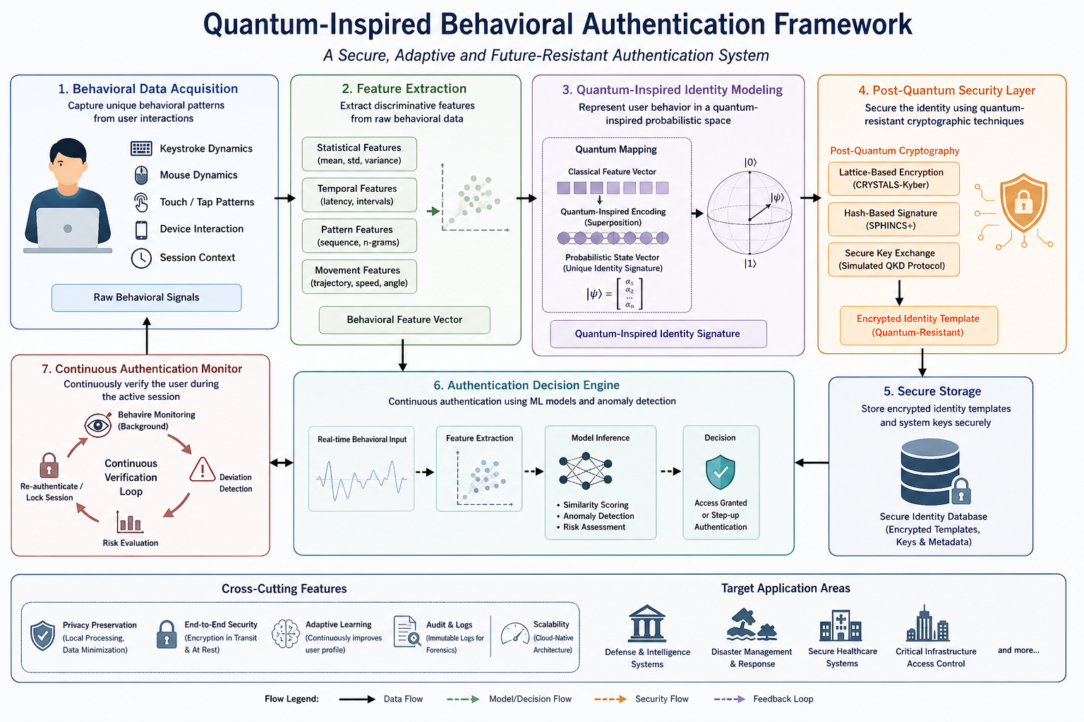

Slide 5
Critical Security Challenges
Static Credential Vulnerabilities
Biometric Spoofing
Passwords, tokens, and OTPs are increasingly compromised through phishing, keylogging, and credential stuffing attacks
Traditional biometric systems (face recognition, fingerprint scanning) can be deceived using masks, photos, or synthetic replicas
Post-Quantum Threats
Session Security Gap
Classical cryptographic algorithms face breaking by future quantum computers using Shor's algorithm and related techniques
Lack of continuous authentication after initial login creates window for session hijacking and privilege escalation attacks

Slide 6

Hybrid Quantum-Behavioral Framework
Behavioral Biometric Capture
Keystroke dynamics, mouse movement patterns, and touch interaction timing create unique user signatures
Quantum-Inspired Identity Modeling
Represent user behavior as probabilistic state vectors inspired by quantum superposition concepts
Post-Quantum Cryptographic Layer
Lattice-based cryptography and hash-based signatures secure identity vectors against quantum attacks
Continuous Authentication Engine
Real-time monitoring with ML-based anomaly detection triggering alerts or re-authentication on deviation

Slide 7
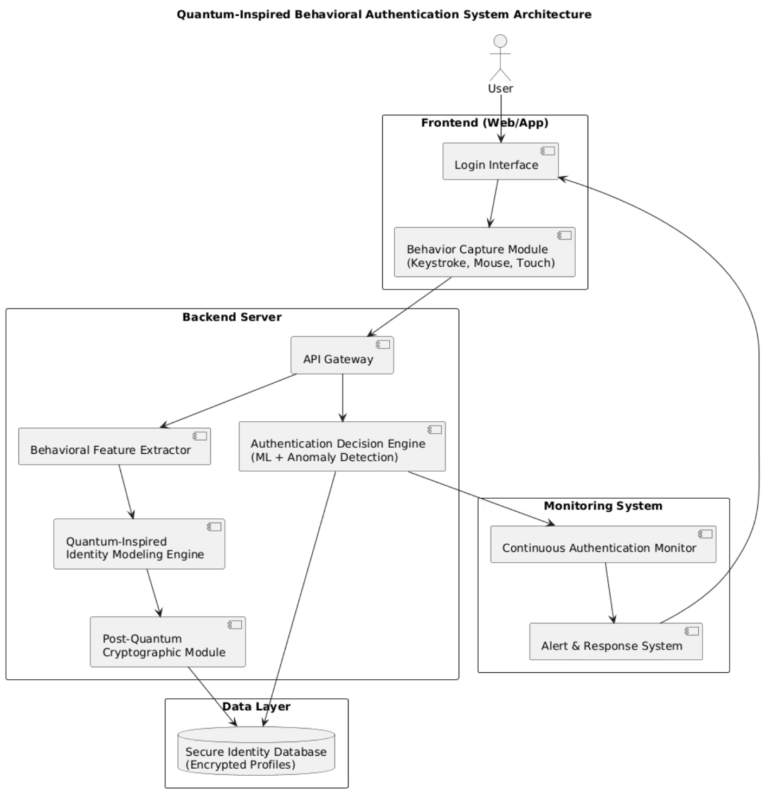
System Architecture
01
Data Collection Module
Frontend behavioral data capture
02
Feature Extractor
Behavioral pattern analysis
03
Identity Engine
Quantum-inspired modeling
04
Security Layer
Post-quantum encryption
05
Decision Engine
ML-based authentication
06
Secure Storage
Encrypted database

Slide 8
Technology Stack
Core Programming
Machine Learning
Python and JavaScript for backend logic, algorithm implementation, and frontend interaction handling
TensorFlow and Scikit-learn for behavioral pattern recognition, anomaly detection, and classification models
Cryptography
Web Framework
Post-quantum libraries implementing lattice-based schemes, hash-based signatures, and quantum-resistant primitives
React frontend with Flask/FastAPI backend for responsive interface and RESTful API endpoints

Slide 9

Security Evaluation Framework
99.2%
<0.5%
Authentication Accuracy
False Acceptance Rate
Unauthorized access attempts incorrectly approved
Correct identification rate on test dataset
<2%
False Rejection Rate
Legitimate users incorrectly denied access

Slide 10



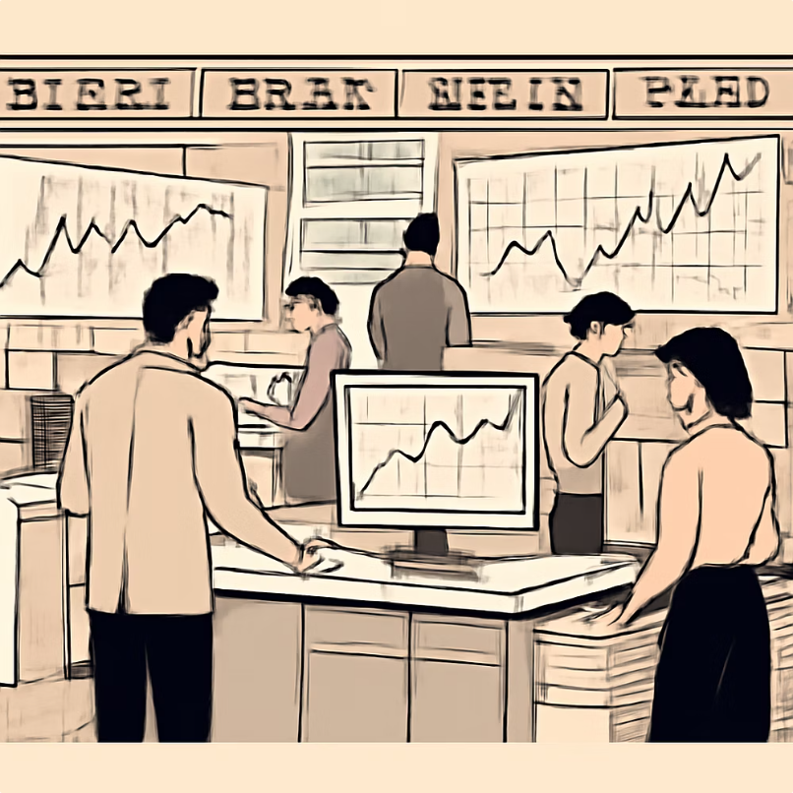
High-Security Use Cases
Defense & Intelligence
Infrastructure Control
Healthcare Systems
Financial Services
Secure patient data access with continuous monitoring preventing session hijacking in medical environments
High-frequency trading platforms and banking systems requiring quantum-resistant transaction authentication
Secure access to classified systems and command-and-control infrastructure requiring continuous authentication
Protection of power grids, water systems, and transportation networks from unauthorized manipulation

Slide 11
Research Innovation Roadmap
Week 1: Research & Design
Week 3: Quantum Integration
Literature review, system architecture design, dataset collection framework establishment
Quantum-inspired modeling layer, post-quantum encryption integration, security hardening
1
2
3
4
Week 2: Core Development
Week 4: Testing & Documentation
Behavioral data capture module, ML model training, basic authentication pipeline implementation
System integration, security testing, IEEE-format research paper preparation, MVP demonstration

